Slide 1

Disruption to Test Scores after Tropical Cyclones in the United States
Art by Amy Wolfe
Gabriella Y Meltzer, Joan A Casey, Joel Schwartz, Michelle L Bell, G Brooke Anderson, Marianthi-Anna Kioumourtzoglou, Robbie M Parks
June 21, 2023
Email: gm3085@cumc.columbia.edu
Twitter: @gabriellameltz

Slide 2

What is a tropical cyclone?
2
Notes:
Time (1 min)
CLICK then leave!
Tropical cyclones, such as hurricanes and tropical storms (such as Henri right now), as you can see an example of here, are intense circular storms that originate over warm tropical oceans and are characterized by low atmospheric pressure, and high wind speeds
They draw energy from the sea surface and maintain strength as long as they remain over warm water
When they make landfall it can be extremely disruptive and very destructive
Several hurricane-force tropical cyclones live long in the memory of many people in the United States
Why should we care about them in relation to health?
CLICK

Slide 3




Why should we care about tropical cyclones?
Very active in US
2020 season most active on record
2021: 3rd time on record names exhausted
Will remain a threat in US
Longer landfall and peak closer to land
Extremely costly
Over $2 trillion in damage
Evidence of serious health consequences
Detailed evidence of hospitalizations
Cyclones are a deadly threat in many vulnerable parts of the world
Knowledge of US impacts helps worldwide efforts
Resilience is a matter of environmental justice
Impact low-income and historically disadvantaged communities
Percentage change in hospitalization rates on days after tropical cyclone exposure
Normalized US hurricane damage from 1900 to 2017.
Landward migration of global tropical cyclone activity.
NOAA
Wang and Toumi, Science, 2021
NASA
Weinkle et al., Nature Sustainability, 2018
Parks et al., Nature Communications, 2021
3
NOAA
Notes:
Time (2 min)
Well they're
CLICK
Very active in the United States
With 30 named storms,
CLICK
2020 was the most active Atlantic hurricane season on record, with 12 tropical storms and 6 hurricanes making landfall in the United States
CLICK
We went into Greek letters, with all the names from our alphabet which you can see here already used up, and you can see that we're already at least at Henri right now in 2021
CLICK
Tropical cyclones will remain a threat in the United States and
CLICK
the threat is also getting worse in some ways, with a recent study showing trends of more tropical cyclones entering coastal regions over recent decades
CLICK
with longer landfalls and peaks in strength closer to land
CLICK
Tropical cyclones are also extremely costly
CLICK
Over the past century in the US, nearly 200 hurricanes have resulted in about
CLICK
$2trillion in normalised damage
CLICK
There is also evidence of how serious their health consequences can be
CLICK
Our recent study of tropical cyclones and hospitalizations showed detailed evidence for the first time of associations with over 100 causes and sub-causes of hospitalizations
CLICK
I’m using an example of hospitalizations in this figure
But previous case studies also show that there is a burden on deaths
CLICK
And also TCs affect many very vulnerable parts of the world!
CLICK
Knowledge we gain using US health and tropical cyclone data can inform what may be happening to a greater degree elsewhere
CLICK
Since nearly half of all people live on the coasts worldwide, there is an important knowledge gap to be filled in here
And
CLICK
resilience to tropical cyclones is fundamentally a matter of environmental justice, as
CLICK
Tropical cyclones tends to impact low-income and historically-disadvantaged communities
So I hope I have set the basis for our recent work
CLICK

Slide 4
Disruption to Test Scores after Tropical Cyclones in the United States
Art by Amy Wolfe
Hurricanes and other tropical cyclones have devastating effects on society
A comprehensive assessment of their impacts on educational attainment over multiple years of study is lacking
4
Meltzer et al., In preparation (please do not share or distribute)
Notes:
Time (0.5 min)
In summary:
CLICK
Hurricanes and other tropical cyclones have devastating effects on society, and
CLICK
A comprehensive assessment of their impacts on cause-specific mortality over multiple years of study is lacking
There is there a clear research gap in comprehensively categorizing the impacts of tropical cyclones on mortality
So what were the aims for this study?
CLICK

Slide 5
Aims
Examine the association between tropical cyclones and educational attainment among elementary- and middle school-age students in all affected areas in the United States
Evaluate how the effects vary by strength of tropical cyclone and by sociodemographic composition of the student bodies and communities affected
5
Meltzer et al., In preparation (please do not share or distribute)
Notes:
Time (0.5 min)
Our Aims with this study, therefore, were to
CLICK
1 Evaluate how tropical cyclones are associated with deaths from major causes up to six months post-cyclone in the United States
CLICK
2 Evaluate how the effects vary by strength of tropical cyclone and by age, sex, and social vulnerability of the communities affected
First, a discussion of the data we used…
CLICK

Slide 6
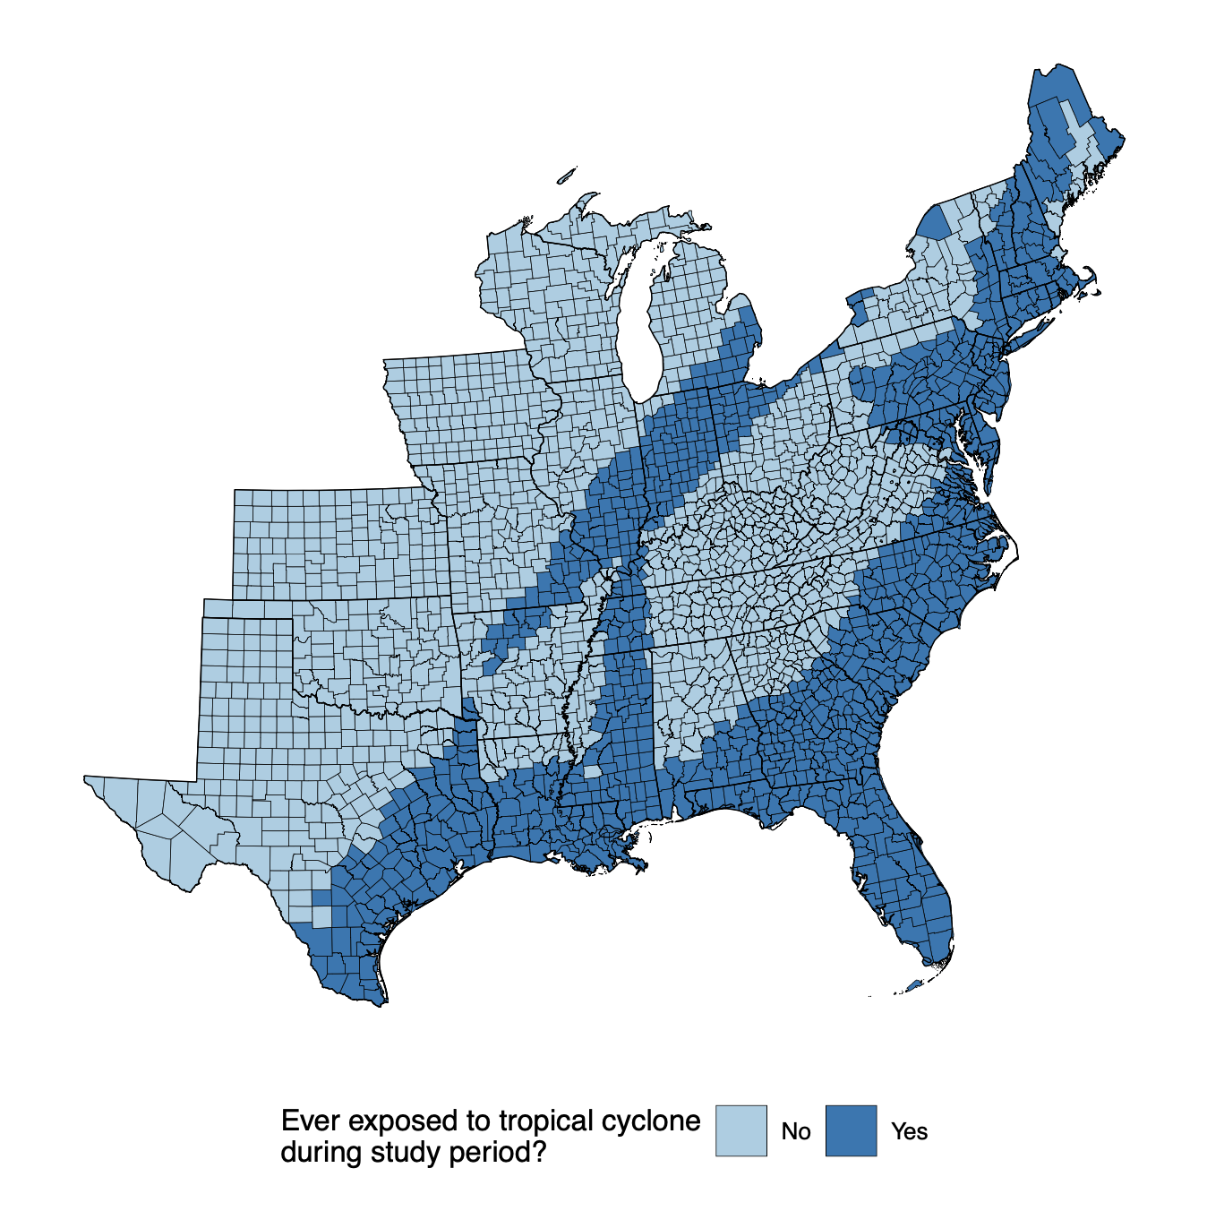
Study population, outcome and exposure assessment
Study population
Third to eighth grade students from 2009-2018 in 2,420 counties in contiguous US
Outcome assessment
County-level average standardized test scores in math and reading/language arts (RLA)
Stanford Educational Data Archive
Exposure assessment
Tropical cyclone exposure
Counties with sustained maximal wind speeds
Tropical cyclones: ⩾ 34 knots
Hurricanes: ⩾ 64 knots
6
Meltzer et al., In preparation (please do not share or distribute)
Notes:
Time (2 min)
Our study population
CLICK 1
was
CLICK 2
a total of nearly 32 million deaths during our study period of 1988 to 2017 (30 years), in around
CLICK 3
1,200 counties which experienced at least one tropical cyclone during the period, and you can see the total deaths
CLICK 4
via the plot on the right. We assessed causes of death
CLICK 5
using
CLICK 6
ICD-9 and -10 codes to create county-level, cause-specific death counts, and divided these causes into
CLICK 7
6 meaningful groups, including
CLICK 8
Cancers, Cardiovascular diseases, Infectious and Parasitic Diseases, injuries, neuropsychiatric conditions, and respiratory diseases (87% of the total deaths which occurred in our study period)
CLICK 9
For our exposure
CLICK 10
for tropical cyclones
CLICK 11
We classed exposures as having winds greater the Beaufort scale gale-force wind speed, which was greater than
CLICK 12
39mph for tropical cyclones
CLICK 13
You can see a map on the right of total tropical cyclone counts
Of those included counties, totals ranged from 1 to 25 days
Most frequent in eastern and south-eastern coastal counties
and for an additional analysis
CLICK 14
we further separated exposures in counties of greater than 73mph for hurricanes
So on to our statistical model
CLICK 15

Slide 7
Statistical model
Association between average Math and RLA and tropical cyclone exposure:
Bayesian formulation of difference-in-differences model
To quantify association:
Associations modeled by tropical cyclones and hurricanes
Associations modeled nationally and by state
Effect modification by county and grade cohort level characteristics
Adjusted for time-varying grade-cohort and county-level covariates:
Grade-cohort: race/ethnicity, economic disadvantage, free/reduced lunch, ESL learners
County: college degree, poverty, household income, urbanicity, SNAP recipients, single mother households
FIGURE 2 HERE: COUNTY POVERTY TERTILES
7
Meltzer et al., In preparation (please do not share or distribute)
Notes:
Time (1 min)
We analyzed
CLICK 1
the association between monthly death rates and tropical cyclones by applying a
CLICK 2
Bayesian conditional quasi-Poisson model
This approach examines contrasts within matched strata, similar to a case-crossover study design in a computationally efficient way.⁵⁶
In this case, we matched
CLICK 3
on county and month of the year, and by doing so,
CLICK 4
examined contrasts within those matched strata and controlled for non-time varying factors varying across counties in our analyses, as well as seasonality
CLICK 5
To quantify the association between monthly death rates and tropical cyclone exposure, we
CLICK 6
Included unconstrained distributed lag terms, for
CLICK 7
up to six months post-cyclone.
CLICK 8
With separate analysis by tropical cyclone category, age group, sex, and social vulnerability
We also
CLICK 9
Flexibly adjusted for
CLICK 10
Longer-term time trends ;
CLICK 11
And Mean monthly temperature
Now that the model's covered, let’s discuss a few result slides for a paper currently under review
CLICK 12

Slide 8
RESULTS 1
8
Meltzer et al., In preparation (please do not share or distribute)
Notes:
Time (1.5 min)
We analyzed the association between tropical cyclones and monthly death rates up to six months post-cyclone (in blue), as well as separately for the subset of hurricanes (in black).
CLICK 1
Results are presented as relative (percentage) changes per monthly increase in cyclone exposure.
We observed the highest overall increases in injury mortality overall,
CLICK 2
with a peak one month after tropical cyclones (5.1%; 95% credible interval [CrI]: 3.9%, 6.2%)
CLICK 3
and a peak for hurricanes on the month of a cyclone (34.6%; 95% CrI: 29.8%, 39.5%).
CLICK 4
Injury death rates remained generally elevated up to four months post-cyclone
Overall, cancer death rates generally did not change in the six months post-cyclone.
CLICK 5
Cardiovascular disease death rates…
CLICK 6
remained higher than usual five months after tropical cyclones (peak at a month post-exposure; 1.8%; 95% CrI: 1.3%, 2.3%) while post-hurricane cardiovascular death rates increased on month of and month after only (peak at month post-exposure; 4.9%; 95% CrI: 3.0%, 6.8%).
Infectious and parasitic disease death rates increased for the first two or three months post-exposure, peaking at
CLICK 7
one month after exposure for tropical cyclones (3.5%; 95% CrI: 1.9%, 5.2%) and
CLICK 8
two months after a hurricane (12.2%; 95% CrI: 5.7%, 18.8%).
Neuropsychiatric condition death rates
CLICK 9
increased only after hurricanes.
Respiratory diseases death rates increased in the month of
CLICK 10
and month after
CLICK 11
hurricanes
CLICK 12

Slide 9
RESULTS 2
9
Meltzer et al., In preparation (please do not share or distribute)
Notes:
Time (1 min)
We also examined the distinct impact of tropical cyclones by age group (0-64 years in brown vs. 65+ years in blue), and I'll highlight some examples...
CLICK 1
We found that increased death rates for infectious and parasitic diseases
CLICK 2
in the months after tropical cyclones were likely driven by deaths in younger ages (0-64 years).
Increases in injury death rates
CLICK 3
were likely larger for 65+ years in the months after tropical cyclones (e.g., at one month after exposure; 7.3%; 95% CrI: 5.1%, 9.5% for 65+ years and 4.1%; 95% CrI: 2.8%, 5.5% for 0-64 years).
CLICK 4

Slide 10
RESULTS 3
10
Meltzer et al., In preparation (please do not share or distribute)
Notes:
Time (1 min)
We also examined the distinct impact of tropical cyclones by CDC social vulnerability index tertiles, from 1 (least vulnerable in blue) to 3 (most vulnerable in red)
CLICK 1
Death rates for cardiovascular diseases
CLICK 2
remained elevated for the most vulnerable counties (in red) in the six months after tropical cyclones, while the change in the two less vulnerable counties (in blue and green) had largely restored to expected levels without a tropical cyclone.
For injuries,
CLICK 3
death rates in the most vulnerable counties (in red) were more than three times larger than the least vulnerable counties (in blue) for the month after tropical cyclones…
CLICK 4

Slide 11
RESULTS 4
11
Meltzer et al., In preparation (please do not share or distribute)
Notes:
Time (0.5 min)
Increases in death rates were fairly similar for females and males, so I won’t focus on these in this presentation…
So in summary…
CLICK 4

Slide 12
Summary
Tropical cyclone exposure associated with:
XXX
Hurricane-force tropical cyclone exposure:
XXX
XXX:
XXX
XXX:
XXX
XXX:
XXX
Valuable insights:
How certain groups may be at increased risk of cause-specific death post-cyclones
12
Meltzer et al., In preparation (please do not share or distribute)
Notes:
Time (1 min)
So as a summary
CLICK
[[[ Then read out...]]]
CLICK

Slide 13
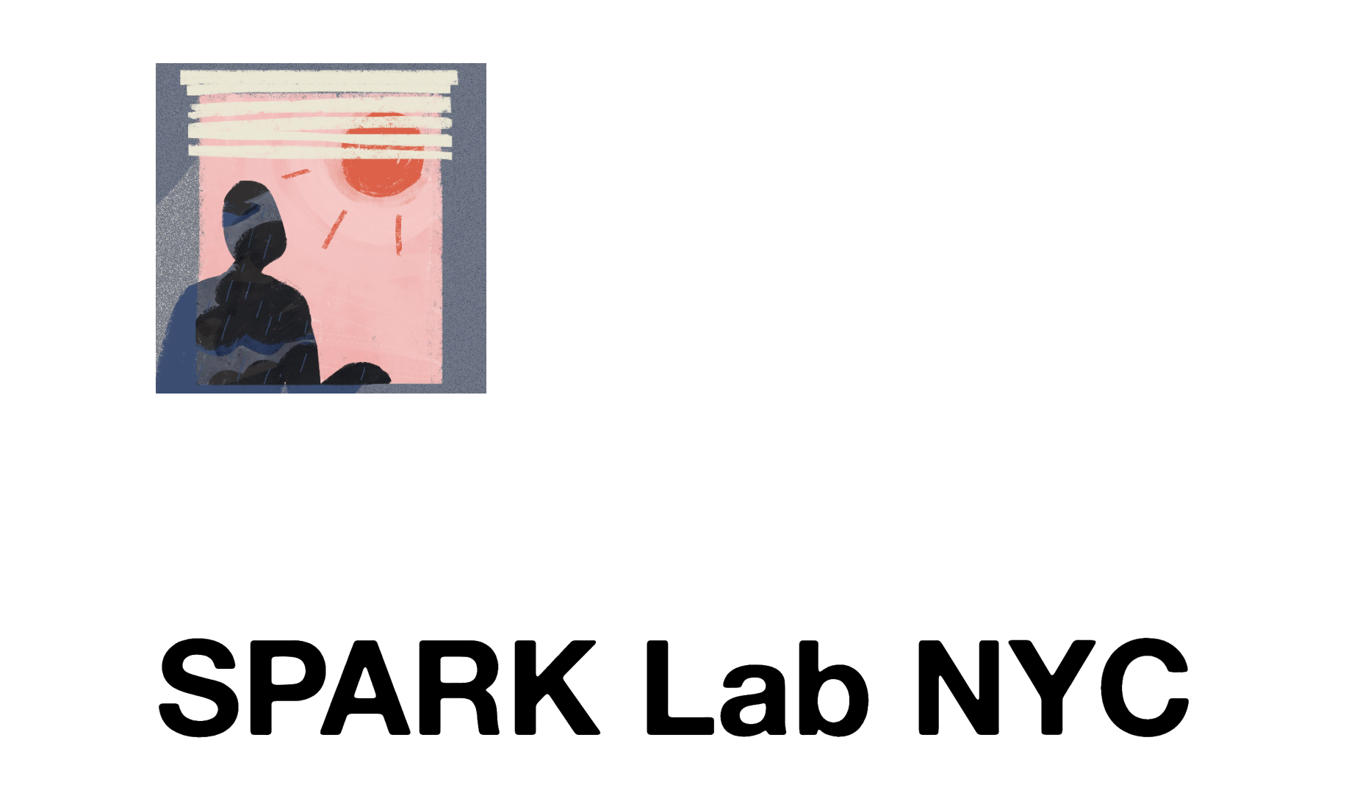

Co-authors, collaborators, and funding
University of Washington
Joan Casey
Columbia University
Marianthi-Anna Kioumourtzoglou, Robbie M Parks
Harvard University
Joel Schwartz
Yale University
Michelle L Bell
Colorado State University
G Brooke Anderson
Supported by:
5T32ES007322-21
R00ES033742
13
Meltzer et al., In preparation (please do not share or distribute)
Notes:
and thanks to all my collaborators and funding
CLICK

Slide 14
Disruption to Test Scores after Tropical Cyclones in the United States
Art by Amy Wolfe
Gabriella Y Meltzer, Joan A Casey, Joel Schwartz, Michelle L Bell, G Brooke Anderson, Marianthi-Anna Kioumourtzoglou, Robbie M Parks
June 21, 2023
Email: gm3085@cumc.columbia.edu
Twitter: @gabriellameltz

